Slide 1

MIS 502 |Data Management for Analytics
Final Project
By Vishal Patidar
Title: Enhancing Indoor localization with Wi – Fi Signal Strength

Slide 2
Contents
Introduction
Data Description
Data Preparation/Data Wrangling
Data Mining
Data Visualization

Slide 3
Introduction
Purpose of the Study: To develop models that improve indoor localization using Wi-Fi signal strengths.
Importance: Critical for navigation in complex structures like university buildings and malls.
Scope: Examination of various indoor locations and Wi-Fi signal behaviors.

Slide 4
Data Description
Composition: Data Collected from 520 Wi – Fi access points (WAP001 – WAP520)
Key Attributes: Signal strengths, geographical coordinates (Longitude, Latitude), floor levels, and building IDs.
Data Collection Context: Extensive measurement campaign across multiple buildings on a campus to enhance indoor localization technologies.

Slide 5
Potential Outcomes
Location Accuracy Improvements
Signal Distribution Insights
Predictive Modeling
System Design Enhancements
Educational & Commercial Applications

Slide 6
Data Quality, Integrity and Ethics
Data Quality:
Completeness, Accuracy & Consistency
Data Integrity:
Anomaly Detection, Duplication, Outlier Management
Data Ethics:
Privacy Protection, Bias Prevention, Transparency

Slide 7
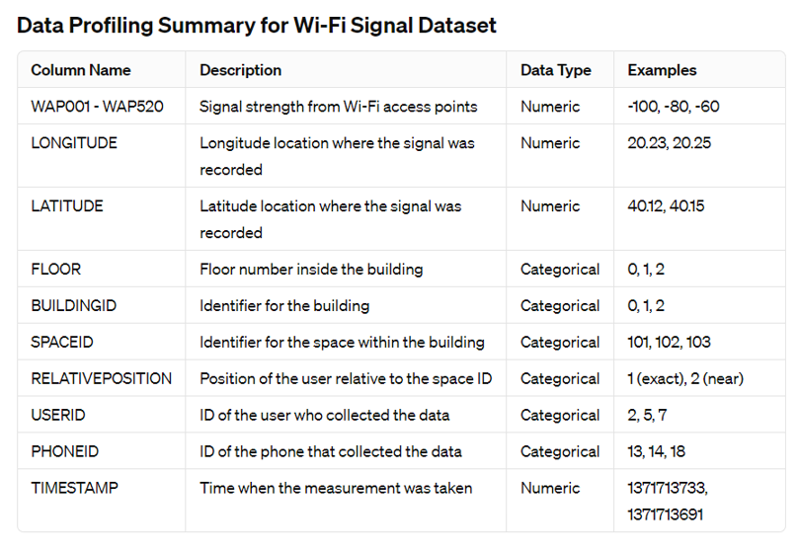
Column Proﬁling

Slide 8
Data Preparation and Data Wrangling
Creation of Target Variable and Concatenation:
Selected and Combined Columns
Transformation into Numerical Format
Preparation of Features:
Feature Selection
Data Cleansing
Data Transformation
Data Splitting for Model Training:
Shuffling and Splitting Data

Slide 9
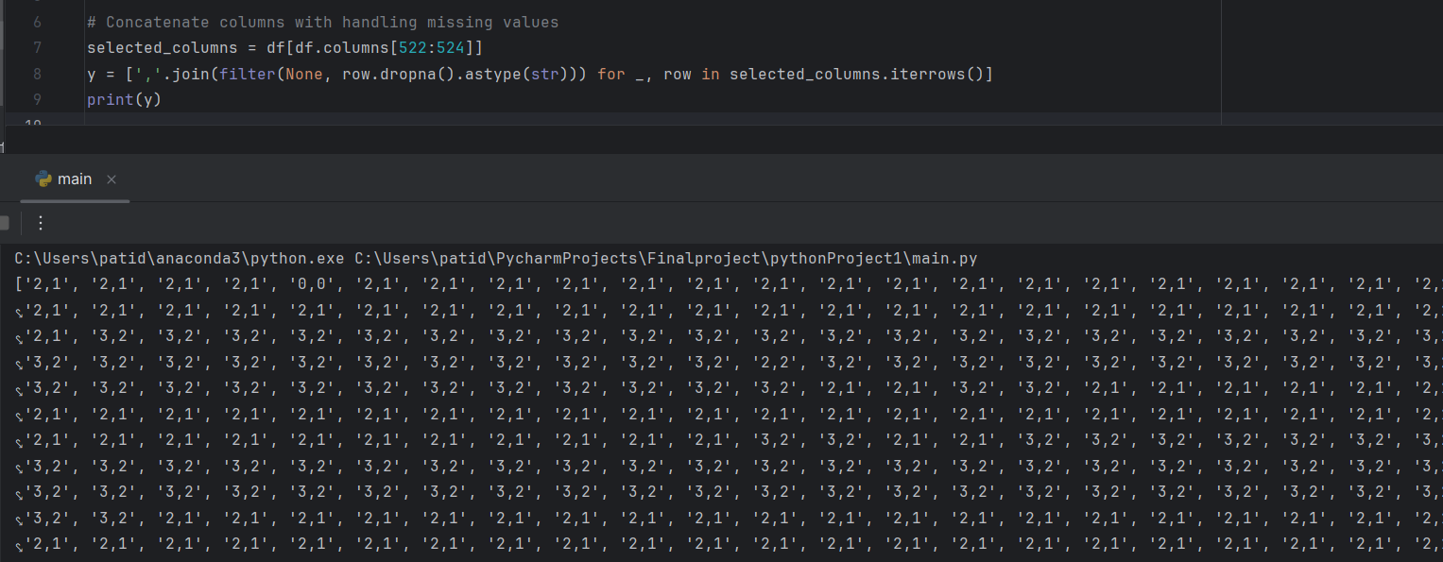
Outcomes

Slide 10
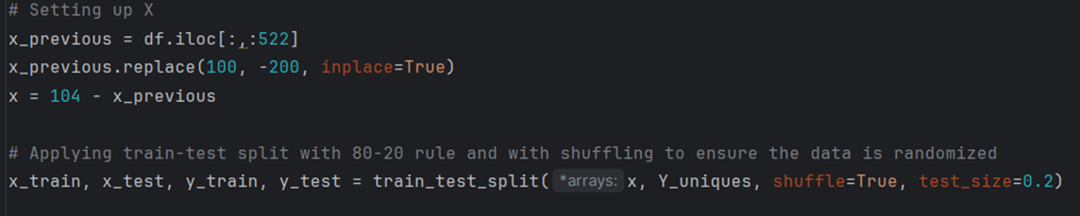
Outcomes

Slide 11
Data Mining
Objective:
To classify floor and building IDs from sensor signal data.
Goals:
Utilize machine learning models for precise indoor location prediction.
Compare the efficacy of different algorithms (Logistic Regression, KNN, and Random Forest).

Slide 12
Models Selection
Logistic Regression:
It’s simple and computationally efficient.
KNN:
For WLAN fingerprints, spatial proximity might indicate similarity, KNN could be effective.
Random Forest:
Its robust, less prone to overfitting and can perform very well in such a scenario.

Slide 13
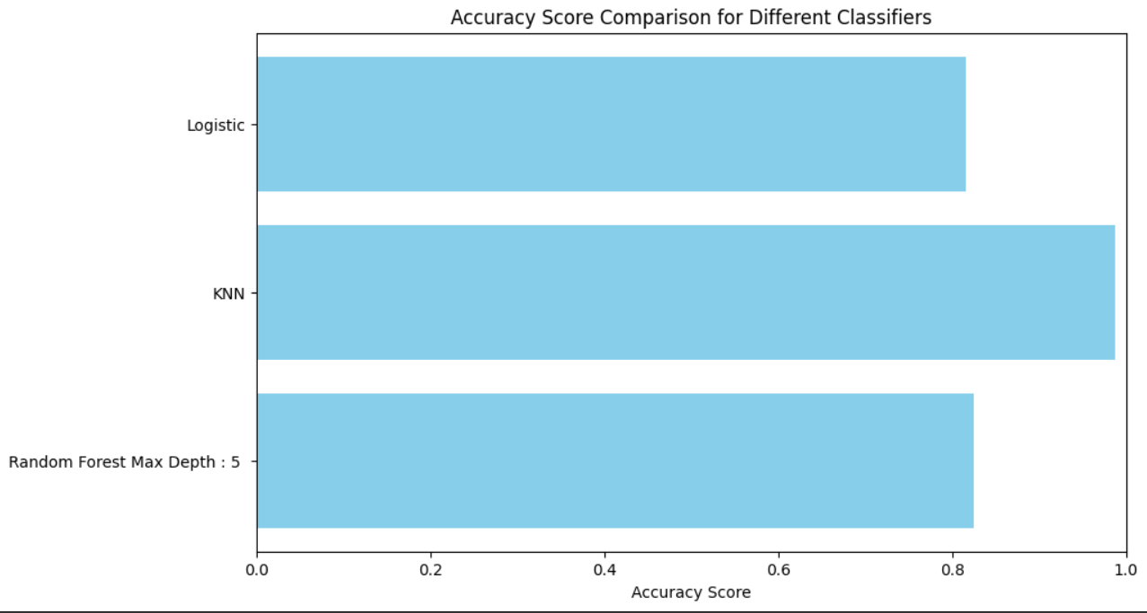
Performance Metrics
As seen in the below graph, KNN gives the best performance for multiclass classification problem.

Slide 14
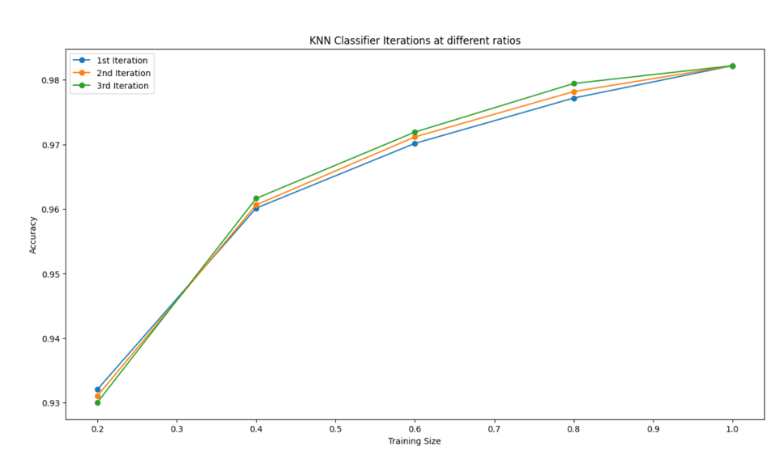
KNN Classifier Iterations

Slide 15
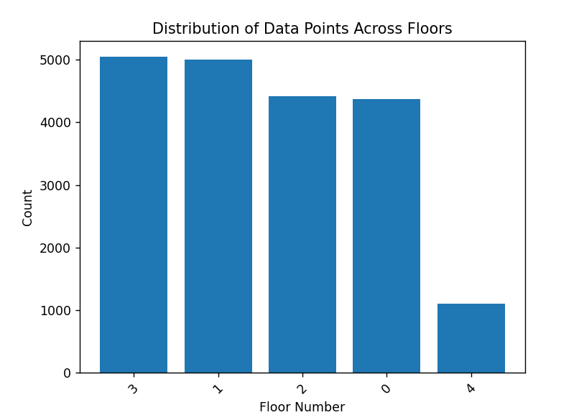
Data Visualization

Slide 16
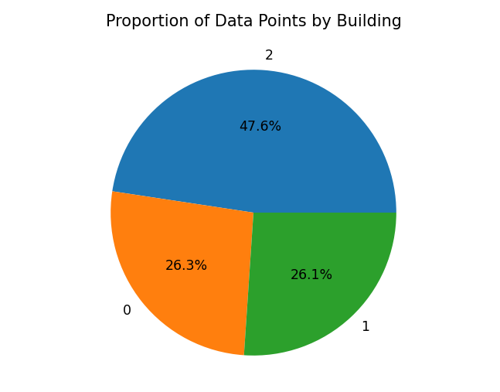
Sensor Data Distribution

Slide 17
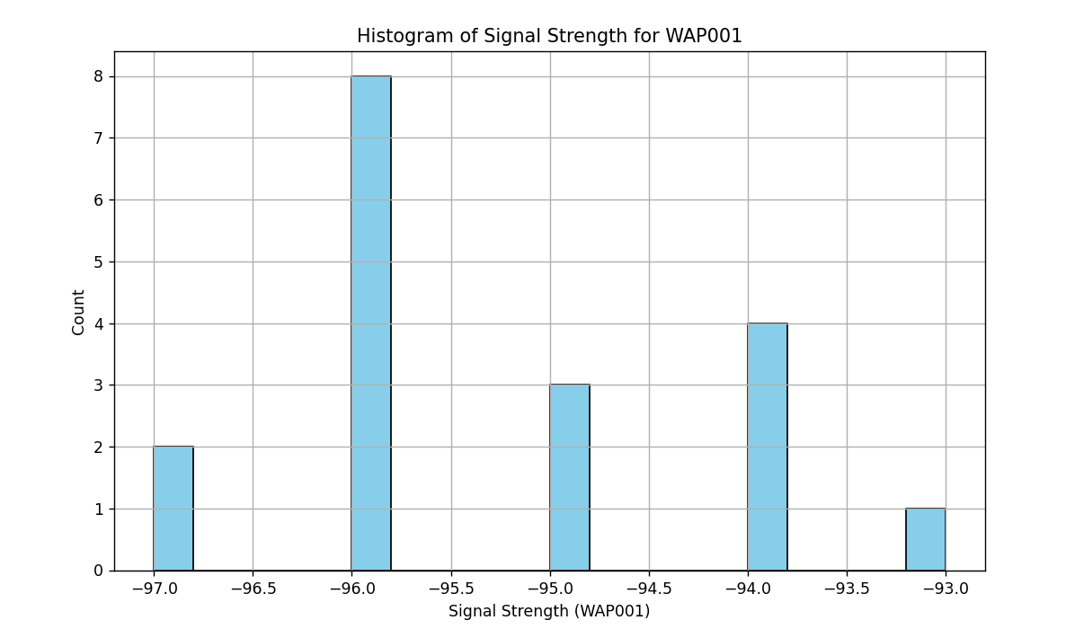
Signal Strength Distribution

Slide 18
Thank You!

